Slide 1
Design Patterns
Unit 10
The Adapter Pattern

Slide 2
Objectives
In this lesson, you will learn to:
The Adapter Pattern (Structural Pattern)

Slide 3
The Adapter Pattern
Intent
  Convert the interface of a class into another interface which clients expect. Adapter lets classes work together that couldn‘t otherwise because of incompatible (不兼容的) interfaces.
Also Known As
  Wrapper (包装器)
Motivation
  Sometimes a toolkit or class library can not be used because its interface is incompatible with the interface required by an application
  We can not change the library interface, since we may not have its source code
  Even if we did have the source code, we probably should not change the library for each domain-specific application

Slide 4
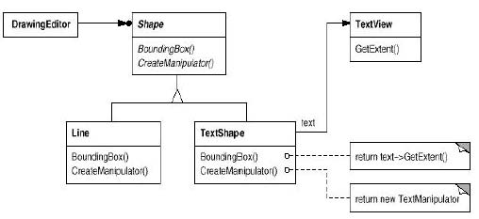
The Adapter Pattern
Motivation
  Example:

Slide 5
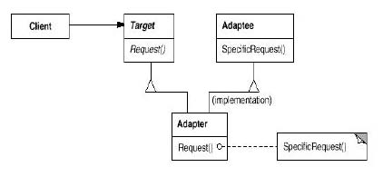
The Adapter Pattern
Structure
  A class adapter uses multiple inheritance to adapt one interface to another:

Slide 6
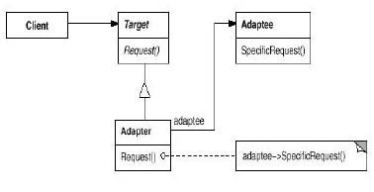
The Adapter Pattern
Structure
  An object adapter relies on object composition:

Slide 7
The Adapter Pattern
Applicability
  Use the Adapter pattern when
  You want to use an existing class, and its interface does not match the one you need
  You want to create a reusable class that cooperates with unrelated classes with incompatible interfaces
Implementation Issues
  How much adapting should be done?
    Simple interface conversion that just changes operation names and order of arguments
    Totally different set of operations
  Does the adapter provide two-way transparency (双向的透明性)?
    A two-way adapter supports both the Target and the Adaptee (被适配者) interface. It allows an adapted object (Adapter) to appear as an Adaptee object or a Target object

Slide 8
Adapter Pattern Example 1
The classic round pegs (钉子) and square pegs!
Here's the SquarePeg class:
  /**
  * The SquarePeg class.
  * This is the Target class.
  */
  public class SquarePeg {
  public void insert(String str) {
  System.out.println("SquarePeg insert(): "
  + str);
  }
  }

Slide 9
Adapter Pattern Example 1 (Continued)
And the RoundPeg class:
  /**
  * The RoundPeg class.
  * This is the Adaptee class.
  */
  public class RoundPeg {
  public void insertIntoHole(String msg) {
  System.out.println("RoundPeg insertIntoHole(): " + msg);
  }
  }
If a client only understands the SquarePeg interface for inserting pegs using the insert() method, how can it insert round pegs? A peg adapter!

Slide 10
Adapter Pattern Example 1 (Continued)
Here is the PegAdapter class:
  /**
  * The PegAdapter class.
  * This is the Adapter class.
  * It adapts a RoundPeg to a SquarePeg.
  * Its interface is that of a SquarePeg.
  */
  public class PegAdapter extends SquarePeg {
  private RoundPeg roundPeg;
  public PegAdapter(RoundPeg peg)
  {this.roundPeg = peg;}
  public void insert(String str)
  {roundPeg.insertIntoHole(str);}
  }

Slide 11
Adapter Pattern Example 1 (Continued)
Typical client program:
  // Test program for Pegs.
  public class TestPegs {
  public static void main(String args[]) {
  // Create some pegs.
  RoundPeg roundPeg = new RoundPeg();
  SquarePeg squarePeg = new SquarePeg();
  // Do an insert using the square peg.
  squarePeg.insert("Inserting square peg...");

Slide 12
Adapter Pattern Example 1 (Continued)
  // Now we'd like to do an insert using the round peg.
  // But this client only understands the insert()
  // method of pegs, not a insertIntoHole() method.
  // The solution: create an adapter that adapts
  // a square peg to a round peg!
  PegAdapter adapter = new PegAdapter(roundPeg);
  adapter.insert("Inserting round peg...");
  }
}
Client program output:
  SquarePeg insert(): Inserting square peg...
  RoundPeg insertIntoHole(): Inserting round peg...

Slide 13
Adapter Pattern Example 2
Notice in Example 1 that the PegAdapter adapts a RoundPeg to a SquarePeg. The interface for PegAdapter is that of a SquarePeg.
What if we want to have an adapter that acts as a SquarePeg or a RoundPeg? Such an adapter is called a two-way adapter.
One way to implement two-way adapters is to use multiple inheritance, but we can't do this in Java
But we can have our adapter class implement two different Java interfaces!

Slide 14
Adapter Pattern Example 2 (Continued)
Here are the interfaces for round and square pegs:
  /**
  *The IRoundPeg interface.
  */
  public interface IRoundPeg {
  public void insertIntoHole(String msg);
  }
  /**
  *The ISquarePeg interface.
  */
  public interface ISquarePeg {
  public void insert(String str);
  }

Slide 15
Adapter Pattern Example 2 (Continued)
Here are the new RoundPeg and SquarePeg classes. These are essentially the same as before except they now implement the appropriate interface.
  // The RoundPeg class.
  public class RoundPeg implements IRoundPeg {
  public void insertIntoHole(String msg) {
  System.out.println("RoundPeg insertIntoHole(): " + msg);
  }
  }
  // The SquarePeg class.
  public class SquarePeg implements ISquarePeg {
  public void insert(String str) {
  System.out.println("SquarePeg insert(): " + str);
  }
  }

Slide 16
Adapter Pattern Example 2 (Continued)
And here is the new PegAdapter:
  /**
  * The PegAdapter class.
  * This is the two-way adapter class.
  */
  public class PegAdapter implements ISquarePeg, IRoundPeg {
    private RoundPeg roundPeg;
    private SquarePeg squarePeg;
    public PegAdapter(RoundPeg peg) {this.roundPeg = peg;}
    public PegAdapter(SquarePeg peg) {this.squarePeg = peg;}
    public void insert(String str) {roundPeg.insertIntoHole(str);}
    public void insertIntoHole(String msg)
    {squarePeg.insert(msg);}
  }

Slide 17
Adapter Pattern Example 2 (Continued)
A client that uses the two-way adapter:
  // Test program for Pegs.
  public class TestPegs {
    public static void main(String args[]) {
      // Create some pegs.
      RoundPeg roundPeg = new RoundPeg();
      SquarePeg squarePeg = new SquarePeg();
      // Do an insert using the square peg.
      squarePeg.insert("Inserting square peg...");
      // Create a two-way adapter and do an insert with it.
      ISquarePeg roundToSquare = new PegAdapter(roundPeg);
      roundToSquare.insert("Inserting round peg...");

Slide 18
Adapter Pattern Example 2 (Continued)
  // Do an insert using the round peg.
  roundPeg.insertIntoHole("Inserting round peg...");
  // Create a two-way adapter and do an insert with it.
  IRoundPeg squareToRound = new PegAdapter(squarePeg);
  squareToRound.insertIntoHole("Inserting square peg...");
  }
}
Client program output:
  SquarePeg insert(): Inserting square peg...
  RoundPeg insertIntoHole(): Inserting round peg...
  RoundPeg insertIntoHole(): Inserting round peg...
  SquarePeg insert(): Inserting square peg...

Slide 19
Summary
The Adapter Pattern

